Slide 1
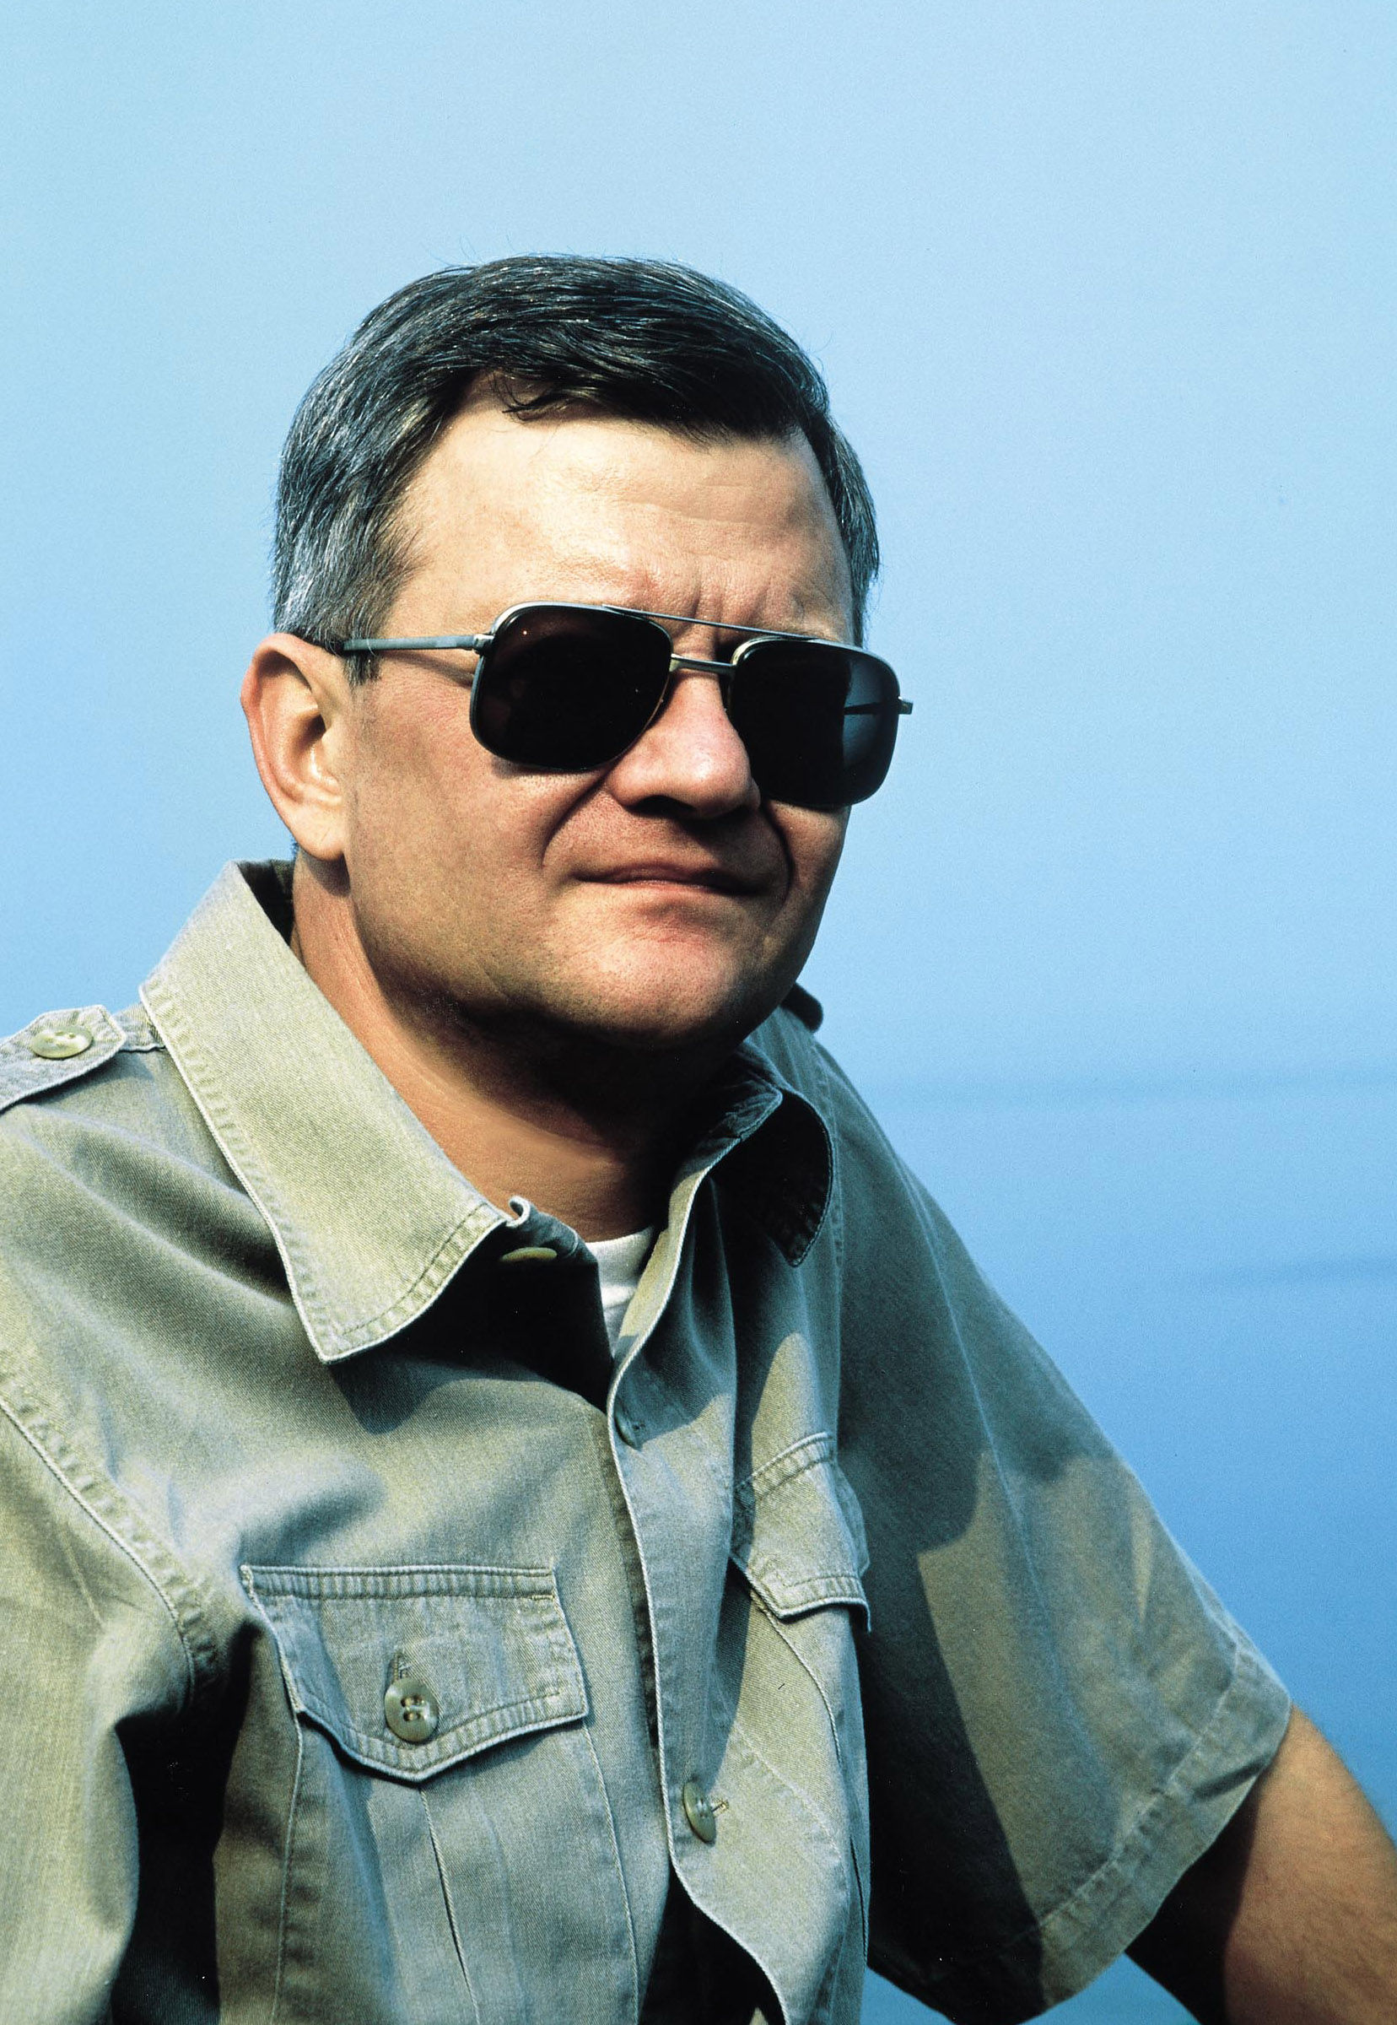
Tom Clancy
By Rishi Masand

Slide 2
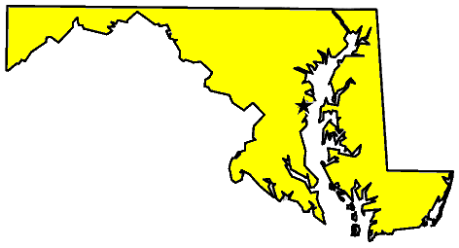
Life
Born in Maryland
Died in Maryland
Parents
Family

Slide 3
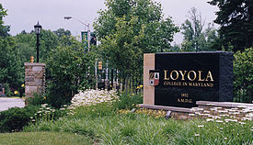
Life
Early interests
High school
Military
College

Slide 4

Life
Married Wanda King
Early occupation
Start of literary career
Literary success

Slide 5
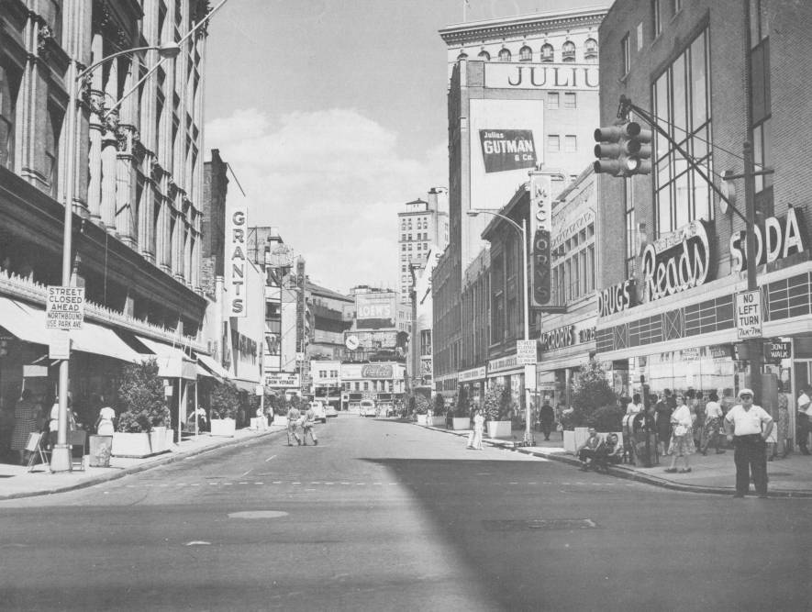
Society
Where he grew up
About Baltimore
Demographics
Civil rights movements

Slide 6

Society
Connecticut
Economy and jobs
Issues

Slide 7

Influences
Early educational influences
Authors

Slide 8

Influences
Military
The American Thriller

Slide 9

Influences
Support
Military access
Presidential acclaim

Slide 10

Literary Contributions
First novel
Themes
Fiction from non-fiction
Realism

Slide 11

Literary Contributions
Novels
Film adaptations
NY Times Best-sellers
Red Storm Entertainment

Slide 12
Works Cited
Bio.com. A&E Networks Television, n.d. Web. 08 Sept. 2015. <http://www.biography.com/people/tom- clancy-9542178#best-seller-status-continues>.
"A Brief Economic History of Modern Baltimore." A Brief Economic History of Modern Baltimore. N.p., n.d. Web. 08 Sept. 2015. <http://www.nathanielturner.com/robertmooreand1199union3.htm>.
Faughnder, Ryan. "Tom Clancy Dies: Sales Figures, by the Numbers." Los Angeles Times. Los Angeles Times, 02 Oct. 2013. Web. 08 Sept. 2015. <http://articles.latimes.com/2013/oct/02/entertainment/la-et-ct-tom-clancy-dies-sales- figures-20131002>.
N.p., n.d. Web. <http://www.angelfire.com/mo2/lairfed/clancyreport.htm>.
N.p., n.d. Web. <http://www.city-data.com/states/Connecticut-History.html>.
"Tom Clancy Biography." -- Academy of Achievement. N.p., n.d. Web. 08 Sept. 2015. <http://www.achievement.org/autodoc/page/cla0bio-1>.
"Tom Clancy: By the Numbers | TIME.com." Entertainment Tom Clancy By the Numbers Comments. N.p., n.d. Web. 08 Sept. 2015. <http://entertainment.time.com/2013/10/02/tom-clancy-by-the- numbers/>.
"Verbosity Chats with Tom Clancy." Verbosity Chats with Tom Clancy. N.p., n.d. Web. 08 Sept. 2015. <http://verbosity.wiw.org/issue6/clancy.html>.

